Slide 1



foamStar validation with ISOPE test cases

Slide 2
foamStar validation with fixed cylinder on NWT

Slide 3

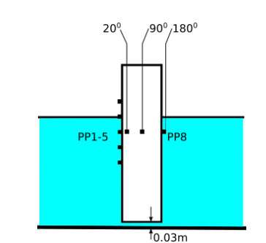
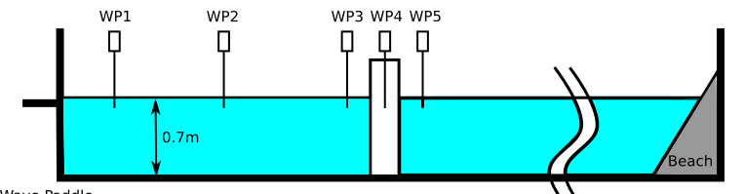
foamStar validation with fixed cylinder
Case description
Parameters | Value
Diameter of Cylinder | 0,22m
Tank Dimension | 110m X 2,2m
Water depth | 0,7m
Tank depth | 2m
Cylinder location | 25m from Wave paddle
Wave details | Focusing wave with wave packet

Slide 4
foamStar validation with fixed cylinder
contents
Chapter 1 : Focusing wave on fixed cylinder
SECTION 1 : Determination of Domain and Grid type
SECTION 2 : Mesh validation with regular waves
SECTION 3 : Mesh validation with fixed cylinder
SECTION 4 : focusing wave validation in 2D/3D NWT
SECTION 5 : focusing wave on fixed cylinder
Chapter 2 : Focusing wave on moving cylinder
SECTION 1 : Determination of Domain and Grid type
SECTION 2 : Mesh validation with regular waves
SECTION 3 : Mesh validation with moving cylinder
SECTION 4 : focusing wave on moving cylinder

Slide 5
Section 1 :
Determination of Domain and Grid type

Slide 6
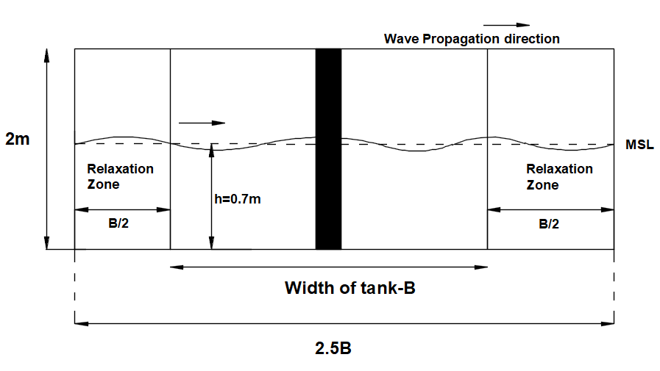
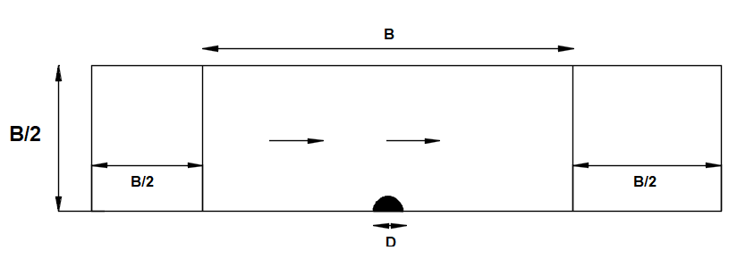
foamStar validation with fixed cylinder
Domain proposal
Fig. Domain Top view
Fig. Domain -Cross section

Slide 7
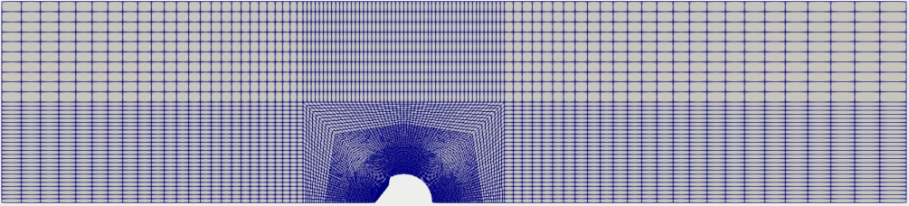
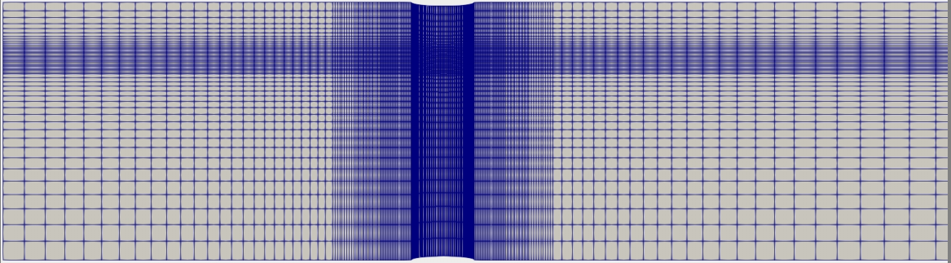
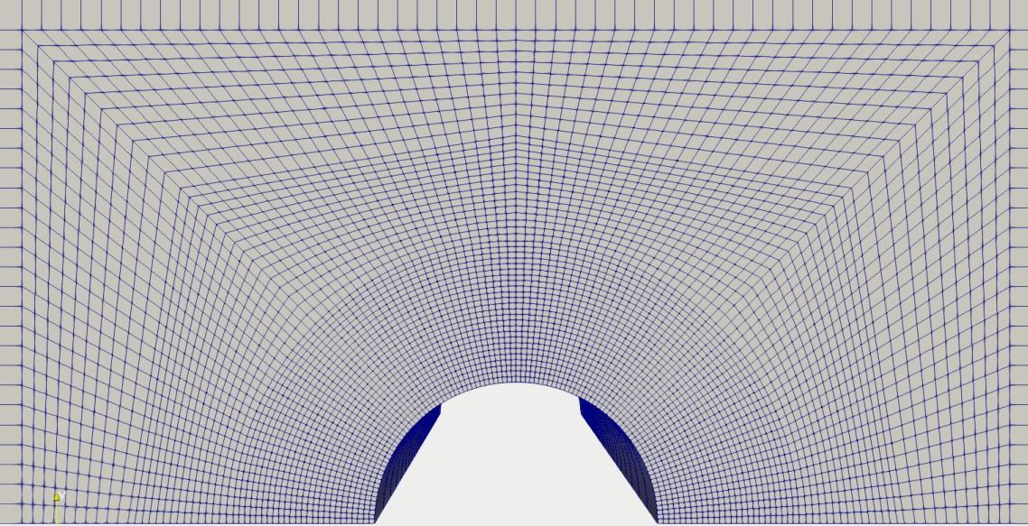
foamStar validation with fixed cylinder
Comments from BV meeting
Sharp change in geometry (May reflect in waves )
Too many cells in relaxation zone

Slide 8
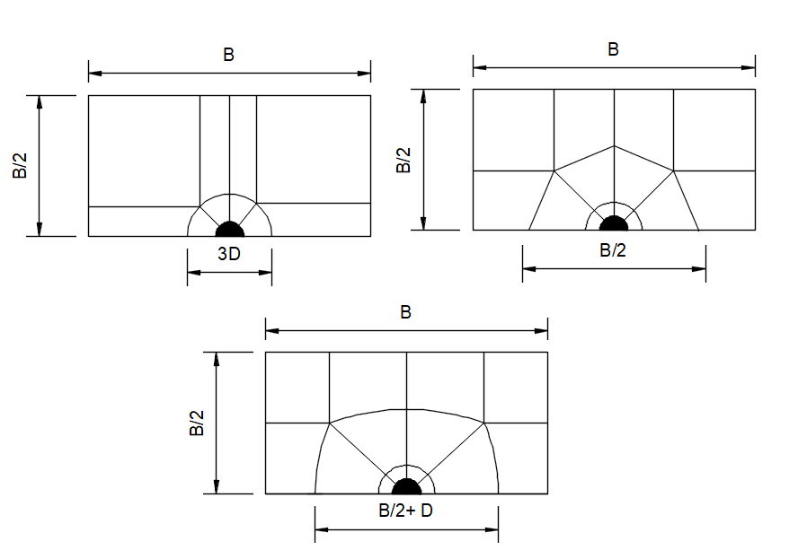
foamStar validation with fixed cylinder
New Domain proposal

Slide 9
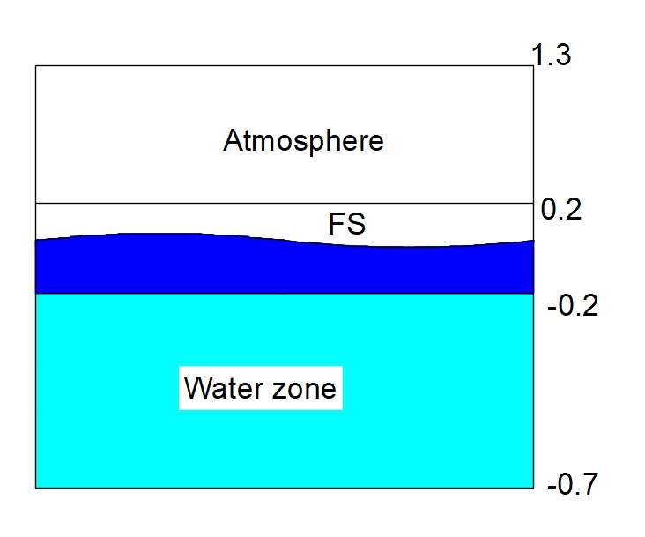
foamStar validation with fixed cylinder
Constant for all domain
Water depth: -0.7m
Atmosphere height: 1.3m
Cylinder diameter: 0.22m
Width of tank, B = 2.22m
Relaxation zone (inlet,Outlet): B (Parametric study to be done)
No of cells in Relaxation zone: 20 cells per zone (Wave direction)
No of cells in vertical direction: Atmosphere ((Cells per H)/5), Water zone ((Cells per H)/2)

Slide 10
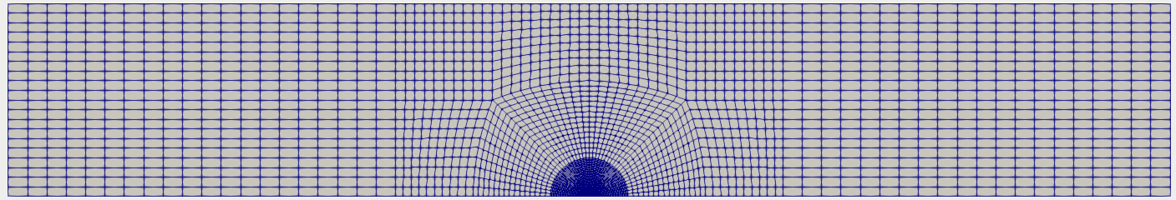
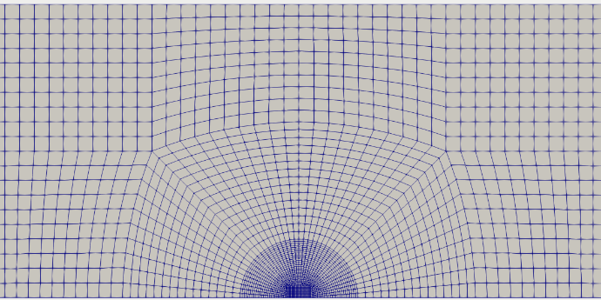
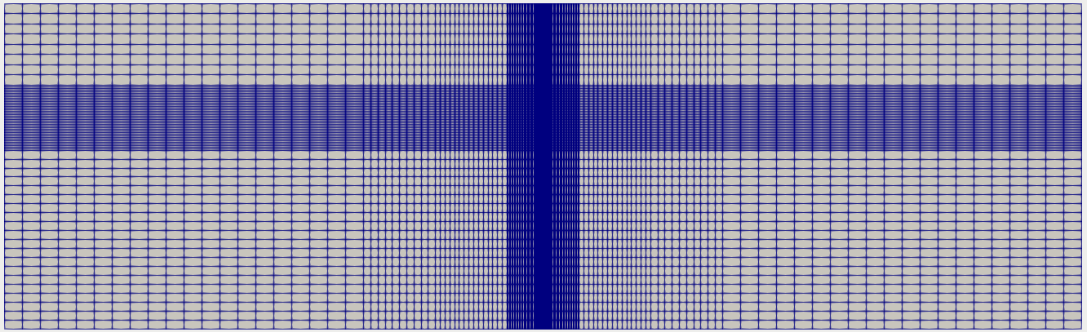
foamStar validation with fixed cylinder
Circular square domain:

Slide 11
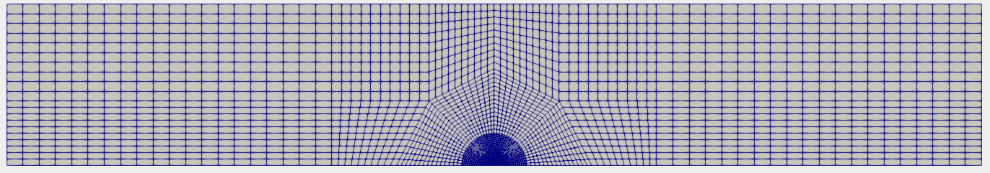
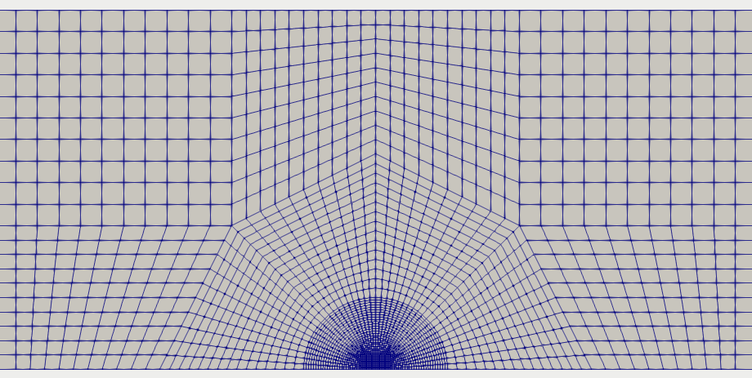
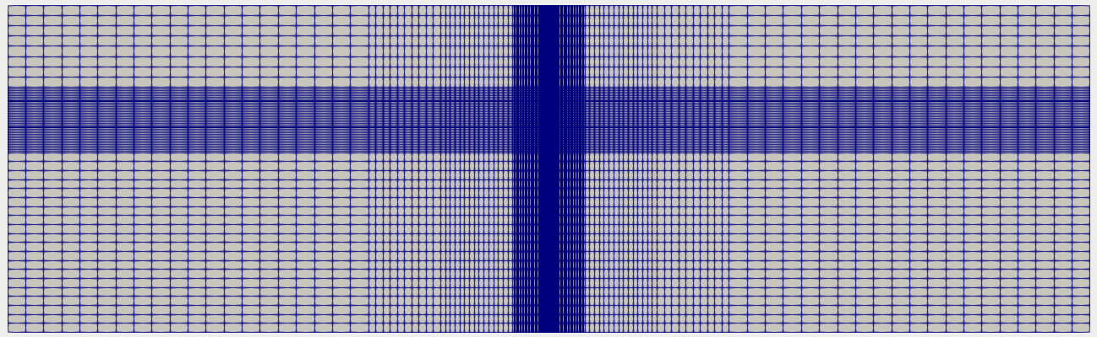
foamStar validation with fixed cylinder
Octagon domain

Slide 12
foamStar validation with fixed cylinder
Domain Comparision
VS
Type | Proposal 2 | Proposal 3
Max aspect ratio | 27 | 27
Mesh non orthogonality | Max 36 Avg:7 | Max 35 Avg:5
Maximum Skewness | 0.6 | 0.7

Slide 13
foamStar validation with fixed cylinder
Under study…
Mesh validation: Mesh validation with Grid Independence study
Regular waves comparison with filled mesh
Perfect mesh to use for the study of focusing waves
Cylinder validation with mesh: Mesh independent study with fixed cylinder
Focusing wave generation in the chosen mesh using Hos and Grid2Grid
Comparing with experimental results by Sriram et al.

Slide 14
Section 2 :
Mesh validation under
Regular waves

Slide 15
foamStar validation with fixed cylinder
Mesh validation study : Regular waves
Keeping Courant number constant…
Case | λ/Δx | H/Δz | T/Δt
Mesh040_dt160t1 | 50 | 5 | 200
Mesh100_dt400t1 | 100 | 10 | 400
Mesh150_dt600t1 | 150 | 15 | 600
Mesh200_dt800t1 | 200 | 40 | 800
Wave conditions
Item | Units
Water depth | 0.7m
Wave period | 0.7018s
Wave height | 0.0575m
Wave length | 0.8082m
Keeping Reynolds number constant…
Case | λ/Δx | H/Δz | T/Δt
Mesh100_dt100t1 | 10 | 20 | 100
Mesh100_dt200t1 | 100 | 20 | 200
Mesh100_dt800t1 | 100 | 20 | 800
Mesh100_dt1600t1 | 100 | 20 | 1600

Slide 16
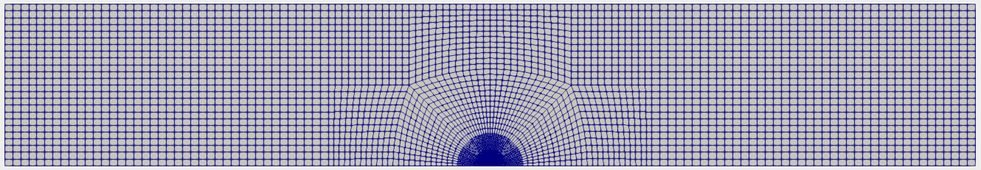
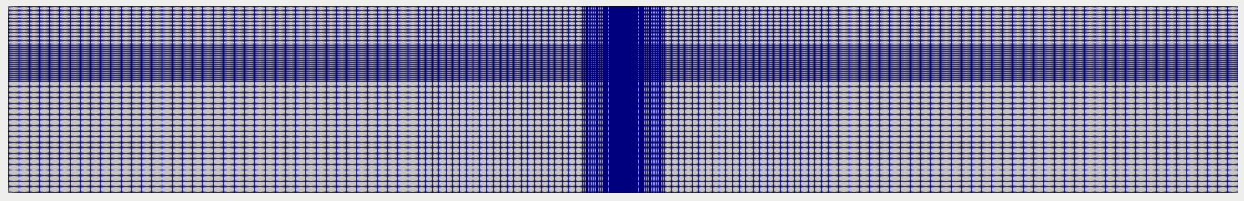
foamStar validation with fixed cylinder
Mesh validation study : Coarse mesh
Test Conditions:
40mesh160dt- 40 cells per wavelength with 5 cells per wave height in vertical direction and 160 time step per wave period
50 cells in the relaxation zone with 1.5λ as inlet and 2λ as outlet

Slide 17
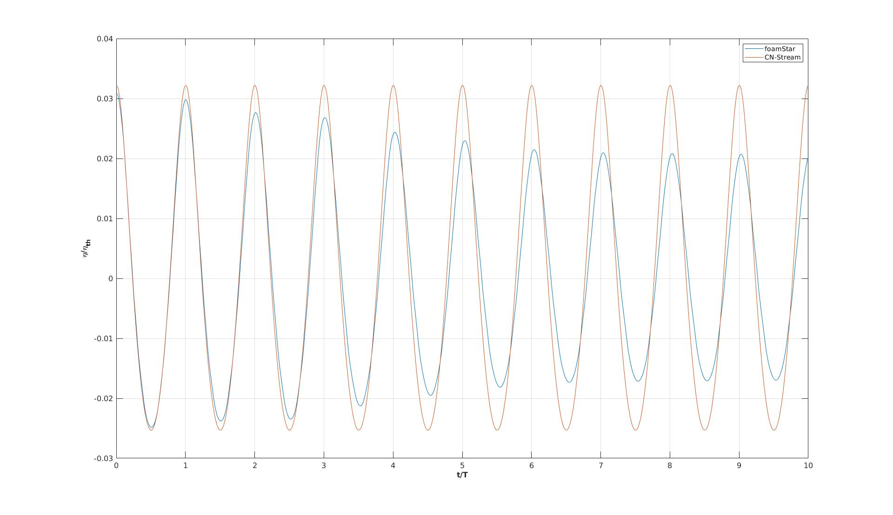
foamStar validation with fixed cylinder
Mesh validation study : Coarse mesh
Test Conditions:
40mesh160dt- 40 cells per wavelength with 5 cells per wave height in vertical direction and 160 time step per wave period
50 cells in the relaxation zone with 1.5λ as inlet and 2λ as outlet
Fig. 40mesh160dt- Very Coarse mesh

Slide 18
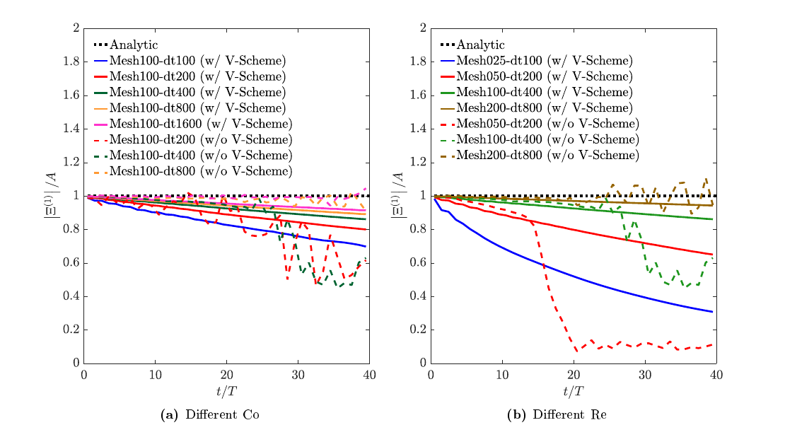
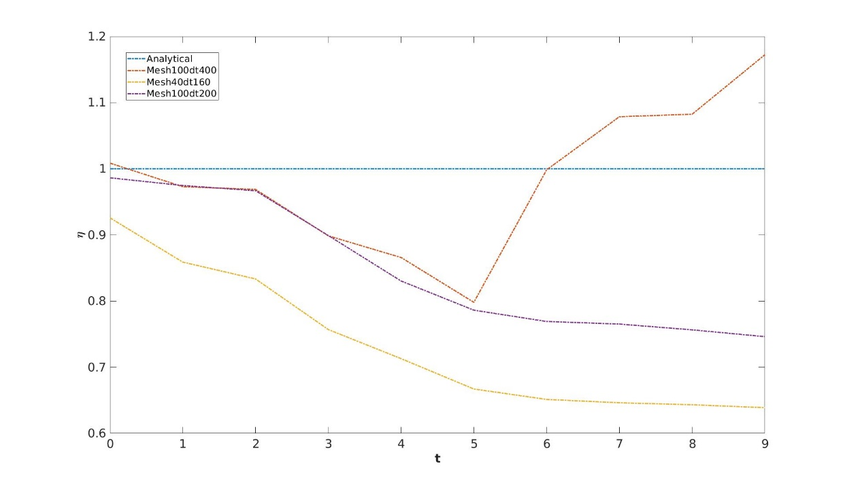
foamStar validation with fixed cylinder
Mesh validation study : Comparision with choi results
Sudden increase in wave observed when reran the file in LIGER
Fig. Choi simulation results for 2D NWT regular waves
Fig. My simulation results for 3D NWT regular waves

Slide 19
foamStar validation with fixed cylinder
Mesh validation study : Regular waves in circular square domain
Keeping Courant number constant…
Case | No of elements | Simulation time | Status
Mesh050_dt100t1 | 0,22 million | 17378s | Finished
Mesh100_dt400t1 | 1 million | 120000s | Finished
Mesh150_dt400t1 | 1,3 million | To be run
Mesh200_dt800t1 | 1,8 million | To be run
Keeping Reynolds number constant…
Case | No of elements | Simulation time
Mesh100_dt100t1 | 1 million | To be run
Mesh100_dt200t1 | 1 million | 80000s | Finished
Mesh100_dt800t1 | 1 million | To be run
Mesh100_dt1600t1 | 1 million | To be run

Slide 20
Section 3 :
Mesh validation with
fixed Cylinder

Slide 21
foamStar validation with fixed cylinder
Mesh validation study : Planned studies
1
Coarse Mesh 100meshdt400- 100 cells per wavelength and 400 time steps per T
2
Medium Mesh 100meshdt800- 100 cells per wavelength and 800 time steps per T
3
Fine Mesh 200meshdt800- 200 cells per wavelength and 800 time steps per T

Slide 22
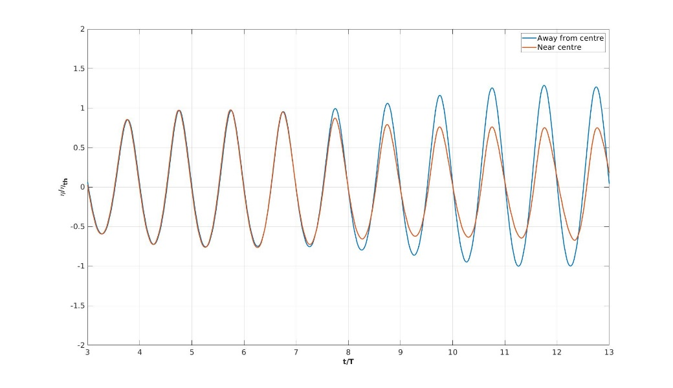

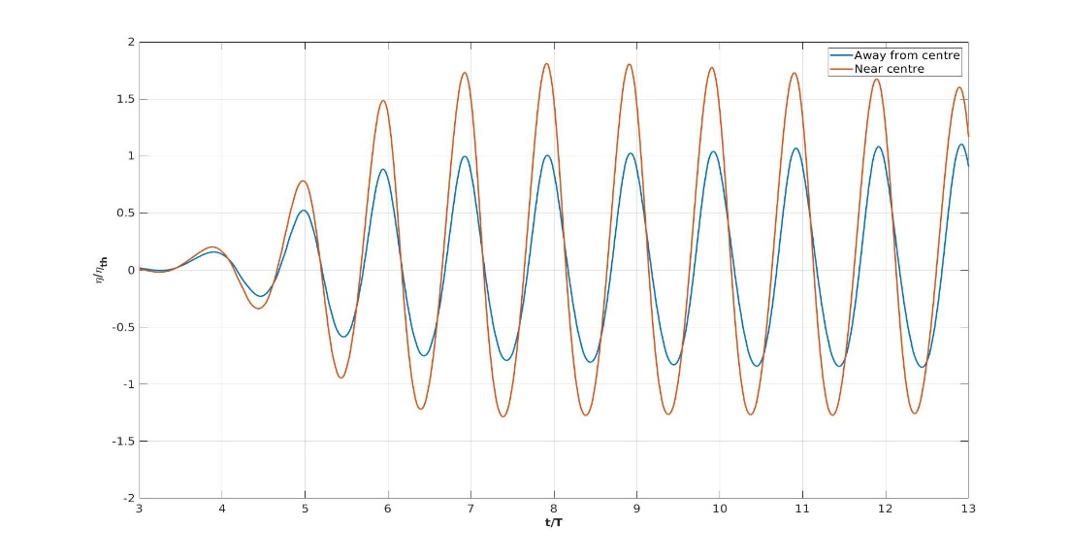
foamStar validation with fixed cylinder
Mesh validation study : Coarse mesh in regular wave
1
1
2
2
Fig. Mesh100dt400- Regular wave with cylinder

Slide 23
foamStar validation with fixed cylinder
Mesh validation study : Observations
Observations:
Reflection from the cylinder happened as expected
But the probe at near wall and near symmetry plane looks different- Need insight in Boundary condition to carry forward for focusing wave case.
Work status:
Work completed : Mesh100dt400
Work under simulation: Mesh100dt800, Mesh200dt800

Slide 24
Section 4 :
Wave validation – focussing wave in 2D/3D NWT

Slide 25
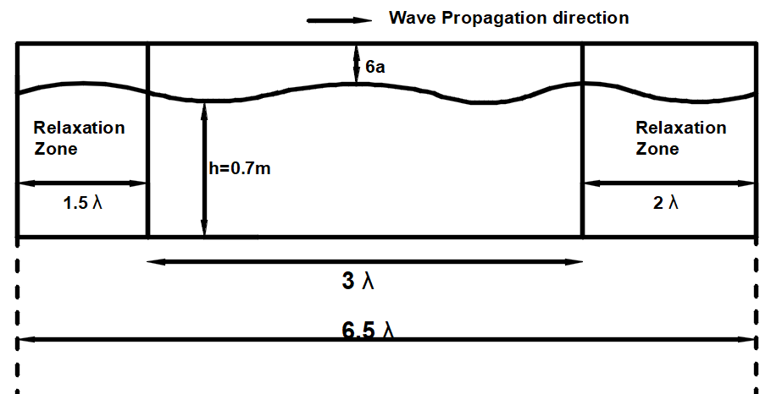
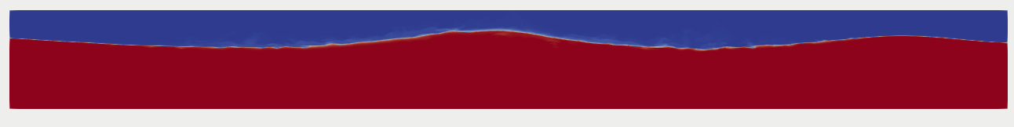
foamStar validation with fixed cylinder
Wave validation study : 2D NWT
Assumptions for Grid Generation: T = 1s, H =0.1m,
Λ=1.56T² , Co=1,U=1.2m/s,
Fig: focusing wave on 2D NWT

Slide 26
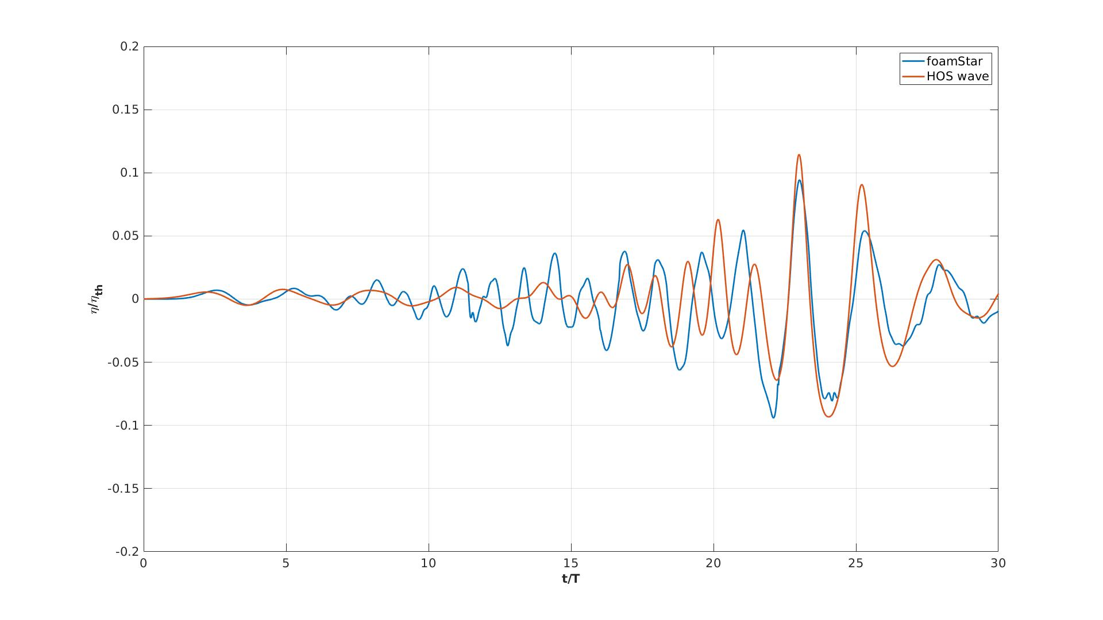
foamStar validation with fixed cylinder
Wave validation study : 2D NWT – Wave comparison
Observations:
Cells are divided based on T=1s and 100cells per wavelength, which may not be true
So minimum cell size influencing the time step adopted.
Modifying the grid cells not based on wavelength and adopting fine time step will adopt better matching (Next work)

Slide 27
foamStar validation with fixed cylinder
Wave validation study : 3D NWT – Wave comparison
Work pending:
File is ready - to be compared for mesh filled in cylinder place for mesh100dt400 case
Generation of mesh for focusing wave has to be confirmed before generation of waves

Slide 28
Section 5 :
Focussing wave on fixed cylinder

Slide 29
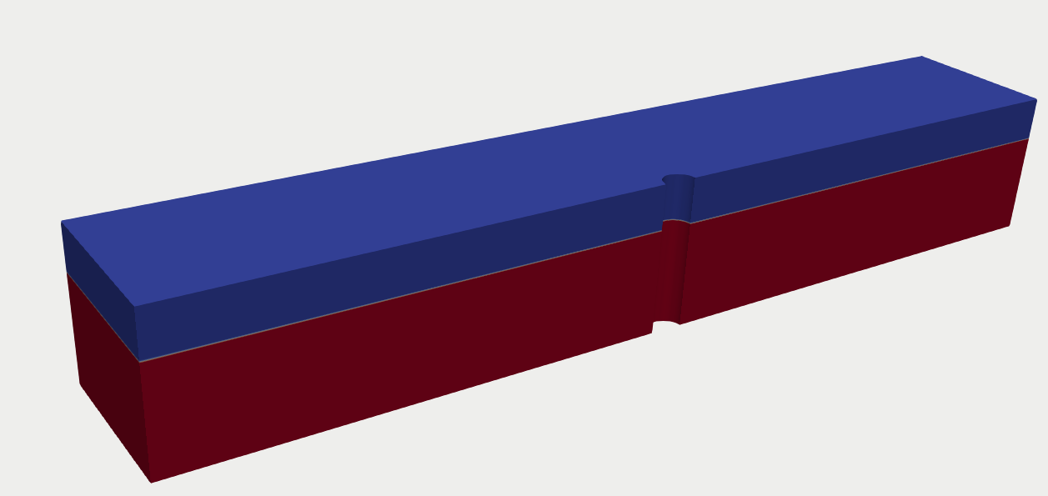
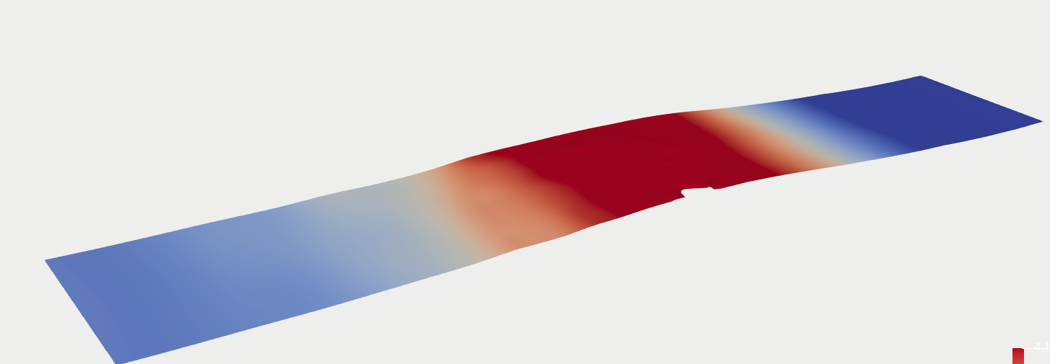
foamStar validation with fixed cylinder
Wave validation study : 3D NWT
Assumptions for Grid Generation:
T = 0,7017s, H =0.1m, - Mesh of 100meshdt400
Λ=1.56T² , Co=1, Δt=0.003125
Fig: focusing wave hitting on fixed cylinder

Slide 30
foamStar validation with fixed cylinder
Wave validation study : 3D NWT
Assumptions for Grid Generation:
T = 0,7017s, H =0.1m, - Mesh of 100meshdt400
Λ=1.56T² , Co=1, Δt=0.003125
Fig: focusing wave hitting on fixed cylinder

Slide 31
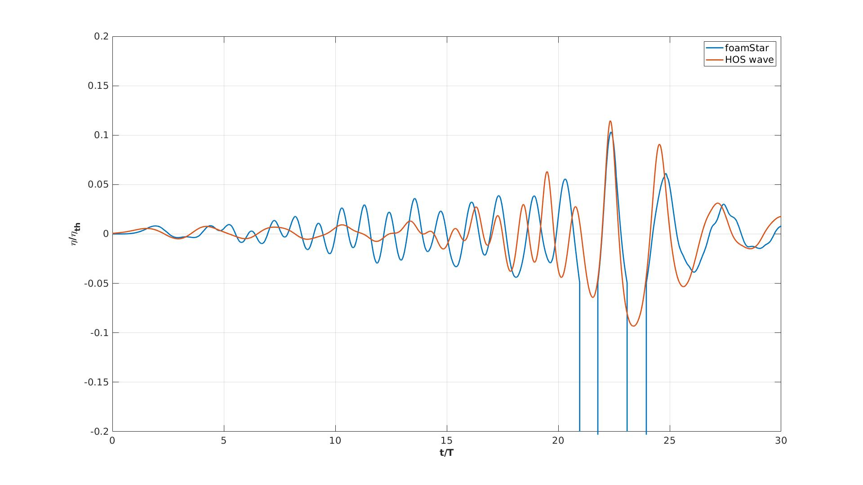
foamStar validation with fixed cylinder
Wave validation study : 3D NWT – Wave comparison
Observations:
Cells are divided based on T=1s and 100cells per wavelength, which may not be true
So minimum cell size influencing the time step adopted.
Modifying the grid cells not based on wavelength and adopting fine time step will adopt better matching (Next work)

Slide 32
foamStar validation with moving cylinder

Slide 33
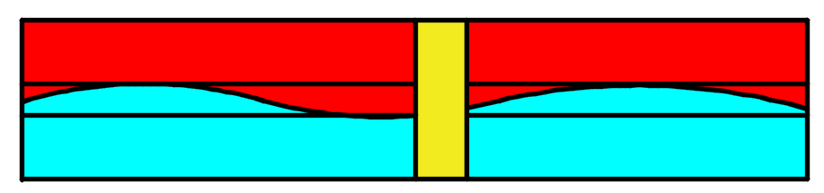
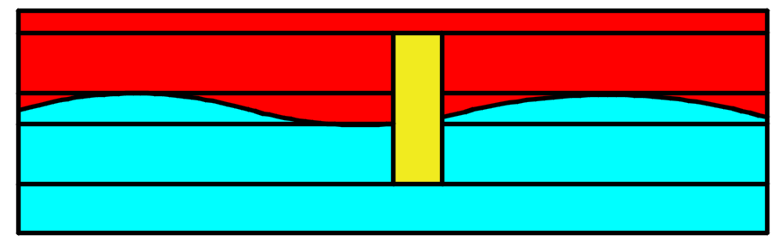
foamStar validation with moving cylinder
Grid Improvement from fixed cylinder
To be improved by introducing 2 extra blocks

Slide 34
foamStar validation with moving cylinder
Work pending in moving cylinder
Mesh generation is almost completed with few face errors
Generation of mesh
Moving cylinder in calm water
Mesh validation with regular waves
Generation of focusing waves with moving cylinder

